Slide 1
Basic Docker commands
Course Code: INT332

Slide 2

$ docker --version
Docker version 18.09.6, build 481bc77

Slide 3
2. Docker info
Get detailed information about docker installed on the system including the kernel version, number of containers and images, etc.
$ docker info
Containers: 3
Running: 1
Paused: 0
Stopped: 2
Images: 3
Server Version: 18.09.6
Storage Driver: overlay2
Backing Filesystem: extfs
Supports d_type: true Native Overlay Diff: true Logging Driver:

Slide 4
3. Checking History .
Shows the history of a docker image with the image name mentioned in the command
$ docker history httpd
IMAGE CREATED CREATED BY SIZE COMMENT

Slide 5
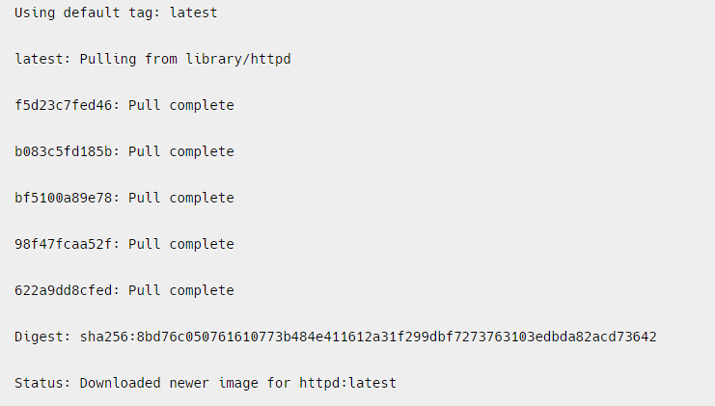
4 . Downloading Image
When we need to pull the docker image from dockerhub (docker repository) then ,the following example of pulling the the image and here we are taking Apache HTTP server image.
$ docker pull httpd

Slide 6
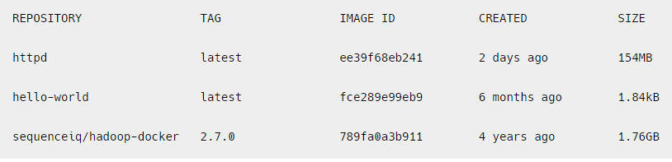
5. Images
To list all the docker images pulled on the system with image details such as TAG/IMAGE ID/SIZE etc.
$ docker images

Slide 7
6.RUN
The ‘docker run’ command is used to create and start a new container from a Docker image. The basic syntax of the ‘docker run’ command is as follows:
docker run [OPTIONS] IMAGE [COMMAND] [ARG…]
where,
OPTIONS: optional flags that configure the behaviour of the container, such as setting environment variables, mounting volumes, etc.
IMAGE: the name of the Docker image to be run.
COMMAND: the command to be executed when the container is started. If not provided, the default command specified in the Docker image will be used.
ARG: optional arguments passed to the command.
-d means

Slide 8
Options Available for executing Docker Run Command
Some commonly used options for executing the docker run command inside a container:
-it: Runs the container in interactive mode, allowing you to interact with the container through the command line.
-d: Runs the container in the background.
-- name: Specifies a name for the container.
-- rm: Automatically removes the container when it exits.
-p: Maps a host port to a container port.
-e / --env: Sets an environment variable inside the container.
-v: Mounts a host volume inside the container.

Slide 9
1st Example : Running a Simple Image:
docker run httpd echo “Hello, World!”
This command runs a new container from the ‘httpd ’ image and executes the ‘echo’ command with the argument “Hello, World!”.

Slide 10
2nd example
Running a Container with a Specific Name:
$ docker run --name my-container httpd echo “Hello, World!”
--name : this option is to give the name of container
my-container: it is the name of container
Echo: it is the command
“hello,world!” – it is argument used
This command runs a new container with the specified name “my-container” from the httpd image and executes the echo command with the argument “Hello, World!”.

Slide 11
What are Environment Variables
Environment variables are key–value pairs used by applications to:
Read configuration
Store secrets (usernames, passwords)
Control application behavior without changing the image
Environment variables allow us to configure containers dynamically.

Slide 12
Need of environment variables in Docker
Without -e:
Configuration must be hard-coded in the image
Need to rebuild image for every change
With -e:
Same image → different behavior
Secure & flexible configuration
Widely used in microservices & cloud deployments

Slide 13
3rd Example : Setting Environment:
docker run -e MY_VAR=value httpd env
This command sets an environment variable ‘MY_VAR’ to the value “value” and runs a new container from the ‘httpd’ image.
The ‘env’ command is executed to display the list of environment variables in the container.

Slide 14
MY_NAME is created inside the container
Host system is not affected
MY_NAME is created inside the container
Host system is not affected
MY_NAME is created inside the container
Host system is not affected
2nd Example: Run a container from Image and display the variable name inside it.
docker run -it -e MY_NAME=Harpreet ubuntu bash
It will open the container and you can check the env variable inside it as:
Echo $ MY_NAME
Kindly note :
MY_NAME is created inside the container
Host system is not affected

Slide 15
Multiple Environment Variables
docker run -e APP_ENV=production -e APP_VERSION=1.0 nginx
Same for MySQL Container
docker run -d \
-e MYSQL_ROOT_PASSWORD=root123 \
-e MYSQL_DATABASE=college \
-e MYSQL_USER=admin \
-e MYSQL_PASSWORD=admin123 \
mysql:8
Without these variables, MySQL container will fail to start

Slide 16
Next is : Passing Environment Variable from Host System
Ex#1:
Step 1: Set variable on host
export APP_PORT=8080
Step 2:
docker run -e APP_PORT nginx env

Slide 17
Another way : Using --env-file (Clean & Professional Way)
Create .env file
DB_HOST=localhost
DB_USER=root
DB_PASS=secret
Then Run container
docker run --env-file .env myapp

Slide 18
4th Example
$ docker run -it -d httpd
Here :
-it flag enables interactive mode, so you can interact with the container’s command line
The -d flag runs the container in the background and the httpd argument specifies the image name to use for the container. This command will pull the httpd image from Docker Hub if it is not already present on your local machine, create a container based on that image, and start it in the background.

Slide 19
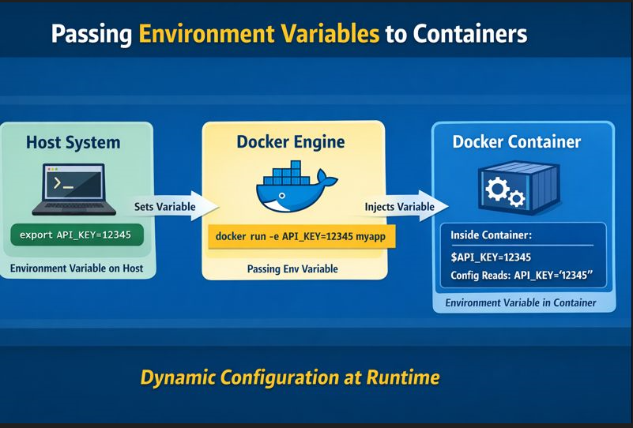

Slide 20
-p optional flag in run command
-p stands for publish port. It maps a port on your host machine to a port inside the container.
In simple words:
-p allows users outside the container to access an application running inside the container.
By default:
Containers run in an isolated network
Applications inside containers are NOT accessible from the host/browser
So if a web server is running inside a container, you must expose it using -p.

Slide 21
Syntax of –p
docker run -p <HOST_PORT>:<CONTAINER_PORT> IMAGE
Part | Description
HOST_PORT | Port on your system (Laptop/Server)
CONTAINER_PORT | Port where app runs inside container

Slide 22
EX#1:
Without –p
docker run nginx
As no port mapping done here
Try opening browser: But it is Not accessible

Slide 23
Now try to Run Nginx with -p
docker run -p 8080:80 nginx
What happens internally?
Browser → localhost:8080 → Docker Host → Container:80 → Nginx

Slide 24
docker run -d -p 3307:3306 --name mysql-test –e MYSQL_ROOT_PASSWORD=root123 mysql
docker exec -it mysql-test bash
mysql -h 127.0.0.1 -P 3306 -u root –p

Slide 25
7 What’s running?
To lists all the docker containers are running with container details. .
$ docker ps
Notes:
25

Slide 26
TASK #1:
Run Ubuntu container
Pass -e COLLEGE=CSE
Show echo $COLLEGE
Stop container → variable disappears
Run Ubuntu container
Pass -e COLLEGE=CSE
Show echo $COLLEGE
Stop container then check what happened

Slide 27
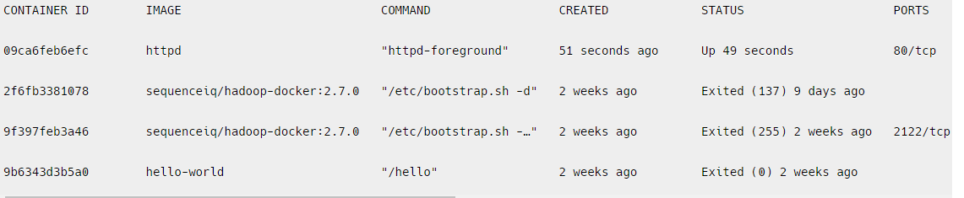
8. ps -a
To list all the docker containers running/exited/stopped with container details
$ docker ps -a

Slide 28
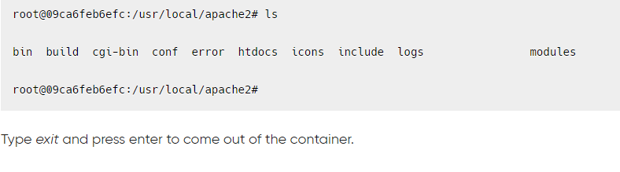
9. exec
Access the docker container and run commands inside the container in bash
$ docker exec -it 09ca6feb6efc bash/env
09ca6feb6efc --- it is Id of the container

Slide 29
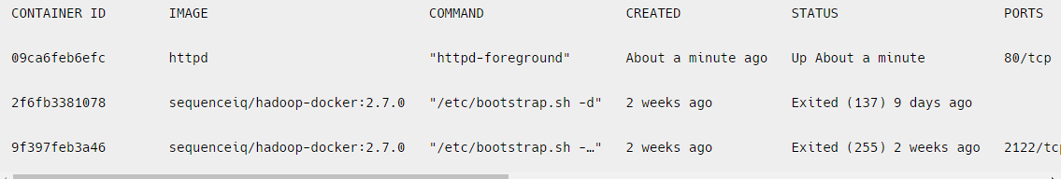
10. Removing container
Remove the docker container with container id mentioned in the command.
$ docker rm 9b6343d3b5a0
Run the below command to check if the container got removed or not.
$ docker ps -a

Slide 30
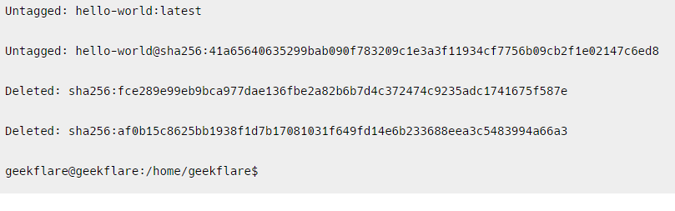
11. Removing image
Remove the docker image with the docker image id mentioned in the command
$ docker rmi fce289e99eb9

Slide 31
..contd..
To remove the image forcefully
$ docker rmi –f <image id>
docker rmi -f 92fa43a2ff60503fdf250
Untagged: httpd:latest
Untagged: httpd@sha256:7765977cf2063fec486b63ddea574faf8fbed285f2b17020fa7ef70a4926cdec
Deleted: sha256:92fa43a2ff60503fdf250ef0a16d4170aa2a47c4b5a60d427724283543a8792a

Slide 32
Docker container commands:
1. Container Lifecycle Management
Run a container (creates and starts it)
docker run -d -p 80:80 --name my_container nginx
Start a stopped container
docker start <container_id/name>
Stop a running container
docker stop <container_id/name>
Restart a container
docker restart <container_id/name>
Pause a container
docker pause <container_id/name>

Slide 33
…contd….
Unpause a paused container
docker unpause <container_id/name>
Kill a container (force stop)
docker kill <container_id/name>
Remove a container
docker rm <container_id/name>
Remove all stopped containers
docker container prune

Slide 34
2. Listing and Inspecting Containers
List all running containers
docker ps
List all containers (including stopped ones)
docker ps -a
Show detailed info about a container
docker inspect <container_id/name>
Display resource usage stats of a container
docker stats <container_id/name>
View container logs
docker logs <container_id/name>
Follow logs in real-time
docker logs -f <container_id/name>

Slide 35
3. Container Interaction
Execute a command inside a running container
docker exec -it <container_id/name> <command>
Attach to a running container's interactive shell
docker attach <container_id/name>
Copy files between container and host
From container to host:
docker cp <container_id>:<container_path> <host_path>
From host to container:
docker cp <host_path> <container_id>:<container_path>
E.g:

Slide 36
Practice questions:
1. You need to start a new container using the nginx image while setting an environment variable ENV_MODE=production. Write the docker run command to achieve this.
2. You have a running container named my_app, but it's not behaving as expected. You want to check its logs to debug any errors. Write the command to view its logs and follow new log entries in real-time.
3. A container named web_server was stopped. Write the command to:a) Start the container again.b) Stop the container when needed.

Slide 37
Docker Volumes
A Docker volume is a persistent storage mechanism used by containers to store data outside the container’s writable layer.
Key idea:
Containers are temporary, volumes are permanent.
If a container:
stops
crashes
is deleted
Volume data stays safe .

Slide 38
Why do we need Docker Volumes?
Without volumes:
Container data is stored inside the container
Deleting the container = data lost
With volumes:
Data is stored on the host machine
Containers can be recreated without losing data
Real-life analogy
Container = Laptop Volume = External Hard Disk You can replace the laptop, but the hard disk data remains.

Slide 39
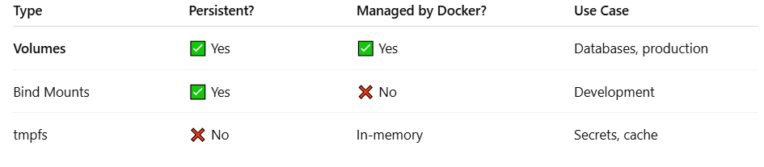
Types of Storage in Docker
Docker provides 3 types of data storage:
Types of Storage in Docker
Docker provides 3 types of data storage:

Slide 40
Characteristics
Stored in:
/var/lib/docker/volumes/
Independent of container lifecycle
Can be shared by multiple containers
Managed fully by Docker

Slide 41
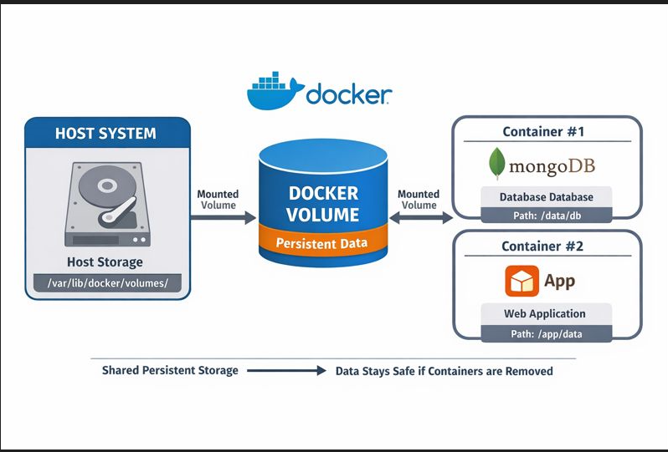

Slide 42
Work on Volumes
Basic commands used to create,inpect,verify , delete/remove the volumes
docker volume create <volume name>
docker volume ls
docker volume inspect mydata
docker run -d -v <volumename>:<path where to store in image> --name <containername> <imagename>

Slide 43
6. To Store Data in a Volume
docker run -it -v <source>:<path of destination> <image name> sh
Then inside the container
echo “msg or data" > /app/data/filename
exit

Slide 44
To Verify Data Persistence: Run another container using the same volume
docker run -it -v <source>:<path of destination> <image name> sh
cat <path of file>

Slide 45
To Remove a Volume
Docker volume rm <volume name>
To Delete All Unused Volumes
docker volume prune

Slide 46
Example#1
1. mkdir C:\docker-volume-demo
2. echo Hello from HOST machine > C:\docker-volume-demo\hostfile.txt
3. docker run -it --name cv1 -v c:\docker-volume-demo:/data ubuntu bash
4. Inside container
ls
cd data
cat hostfile.txt
5. Modify file INSIDE container
echo "Modified inside container" >> /data/hostfile.txt
exit

Slide 47
Practice Question
Create a Docker volume named studentdata.
Run an Ubuntu container and mount studentdata at /student.
Create a file inside the container and verify it persists after container deletion.
Attach the same volume to another container and verify the file exists.
Demonstrate data sharing between two containers using a shared volume.
Show that deleting a container does NOT delete the volume data.

Slide 48
Create a Docker volume named studentdata. Run an Ubuntu container and mount studentdata at /student. Create a f-mount -- Mount It is the modern, explicit, key-value way to attach storage to a container. It can be used for: Volumes Bind mounts tmpfs mounts Compared to -v, it is: More readable Less error-prone Better for production & teaching concepts ile inside the container and verify it persists after container deletion. Attach the same volume to another container and verify the file exists. Demonstrate data sharing between two containers using a shared volume. Show that deleting a container does NOT delete the volume data.
Create a Docker volume named studentdata.
Run an Ubuntu container and mount studentdata at /student.
Create a file inside the container and verify it persists after container deletion.
Attach the same volume to another container and verify the file exists.
Demonstrate data sharing between two containers using a shared volume.
Show that deleting a container does NOT delete the volume data.

Slide 49
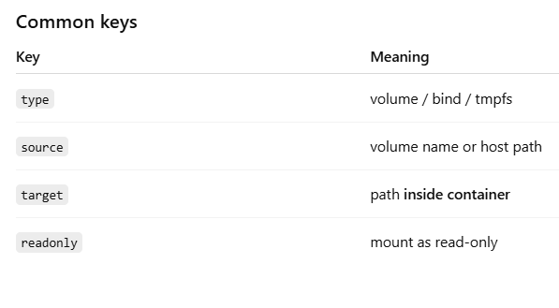
Syntax
docker run --mount type=<type>,source=<src>,target=<dest> IMAGE

Slide 50
Example 1: Named Volume (Most Common & Recommended)
Create a volume
docker volume create mydata
Run container with --mount
docker run -it –mount type=volume,source=mydata,target=/app/data ubuntu
Inside container
cd /app/data
echo "Hello from volume" > file1.txt
exit
Run another container
docker run -it –mount type=volume,source=mydata,target=/app/data ubuntu
cat /app/data/file1.txt

Slide 51
What happened
mydata volume lives on Docker host
Data persists even after container stops
Multiple containers can share it
Best for databases, logs, application state

Slide 52
Example 2: Bind Mount (Host ↔ Container Sync)
Host folder
C:\docker\website\index.html
Run container
docker run -it --mounttype=bind,source="C:\docker\website",target=/usr/share/nginx/html -p 8080:80 nginx
Edit file on HOST
<h1>Hello from Host</h1>
Browser
http://localhost:8080
Effects ………
Host directory is directly mapped
Changes on host reflect instantly
Container restart does NOT affect data
Best for development, live code editing

Slide 53
Equivalent commands for Volume and mount
-v mydata:/data
--mount type=volume,source=mydata,target=/data

Slide 54
Practice Question #
To demonstrate real-time file synchronization between host and container.
On the host system, create a directory named webdata.
Inside it, create a file index.html with the content:
<h1>Welcome from Host</h1>
Run an Nginx container and bind mount the host directory to /usr/share/nginx/html using --mount.
Expose the container on port 8080.
Open a browser and verify the page loads.
Modify index.html on the host to:
<h1>Updated from Host</h1>
Refresh the browser and observe the change.

Slide 55
The --network flag tells Docker how the container should connect to the network.
It decides how containers talk to each other, the host, and the outside world.
Syntax
docker run --network <network_name_or_mode> IMAGE
docker run --net <network_name_or_mode> IMAGE
Default behavior (important concept)
If you do not specify --network, Docker automatically connects the container to:
bridge network
--network in docker run

Slide 56
Types of Docker networks you can use with --network
Bridge network (DEFAULT)
User-defined bridge network
Host network
None network
Overlay Network

Slide 57
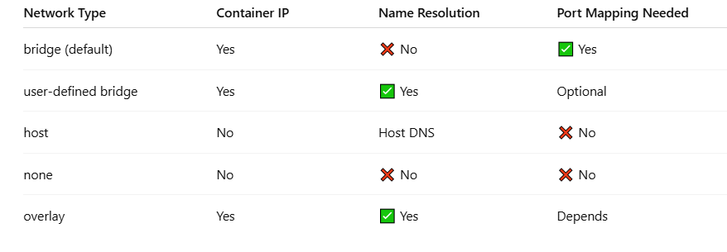
Comaprison among all

Slide 58
Real-life analogy
bridge → Private apartment with gate
user-defined bridge → Office LAN
host → Living directly on main road
none → No phone, no internet

Slide 59
Need of User-Defined Network
Automatic DNS-based container name resolution
Clean microservices communication
Isolation + flexibility
For this :
Create a custom network
docker network create mynet
Run containers on same network
docker run -d --name app --network mynet nginx
docker run -d --name db --network mynet mysql

Slide 60
When to use Host Network
Container shares host’s network stack
No separate IP for container
Ports are exposed directly on host
Example
docker run --network host nginx
Access directly:
http://localhost:80

Slide 61
None network
What happens?
Container has no network access
No IP, no internet, no communication
Example
docker run --network none busybox
✔ Fully isolated container
Use case
Security
Offline processing

Slide 62
Overlay network (Docker Swarm)
Used in multi-host Docker Swarm setups.
Not used with normal docker run unless Swarm is enabled.

